Slide 2

Video https://www.youtube.com/watch?v=qti8j5xKqSQ

Slide 3
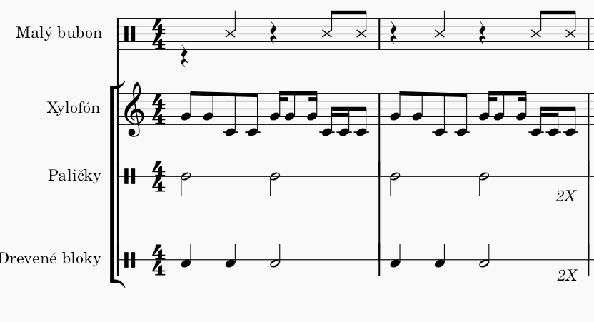

Slide 4
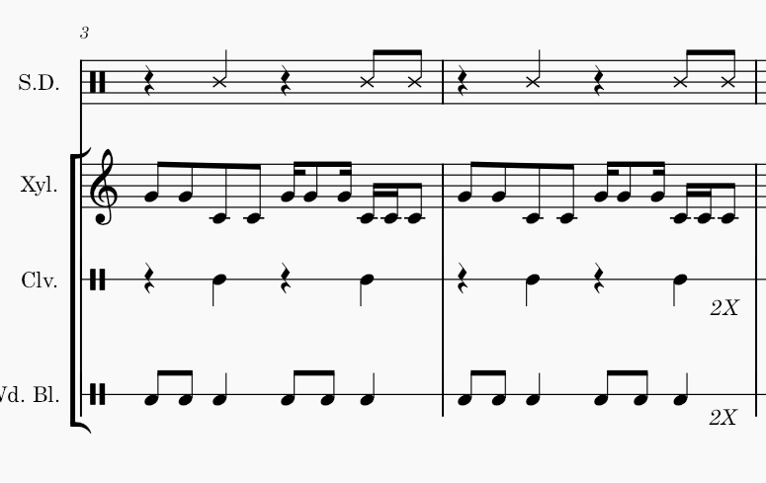

Slide 5
